Slide 1
Alzheimer's induced Dementia Prediction from MRI Images using Image Segmentation
1905035 - Farhan Tahmidul Karim
1905045 - Md. Ishrak Ahsan
Group ID: A2_4

Slide 2
Problem Definition
But how?
Progressive neurological disorder, affecting thinking, memory, behavior and ability to work
EARLY DIAGNOSIS !!
MRI imaging gives visualization of brain structures allowing analysis of atrophy pattern
focusing on specific brain regions affected early, like the hippocampus, can give clues
Image segmentation isolates regions of interest in MRI scans, facilitating the quantitative analysis
Image data driven ML models > Clinical and voice data [1]
Hippocampus Segmentation-Based diagnosis and classification of MRI Images is effective [3]
U-net style model for AD diagnosis using 3D T1-weighted MRI pays more attention to hippocampus, cortex regions etc. [4]
U-Net Convolutional Network based approach for hippocampus segmentation from 2D brain images segment hippocampus with an average performance rate of 93.6% [5]
Notes:
Machine Learning for Dementia Prediction: A Systematic Review and Future Research Directions | Journal of Medical Systems
Dementia Prediction Using Machine Learning - ScienceDirect
Hippocampus Segmentation-Based Alzheimer’s Disease Diagnosis and Classification of MRI Images | Arabian Journal for Science and Engineering
U-net based analysis of MRI for Alzheimer’s disease diagnosis

Slide 3
Available Dataset
OASIS Project: The Open Access Series of Imaging Studies (OASIS) is a project aimed at making MRI data sets of the brain freely available to the scientific community. ^{[1][2]}
OASIS Alzheimer's Detection: OASIS MRI dataset consists of 80,000 brain MRI images. The images have been divided into four classes (Non/very mild/mild/moderate dementia) based on Alzheimer's progression. The dataset aims to provide a valuable resource for analyzing and detecting early signs of Alzheimer's disease. ^{[3]}
Notes:
https://sites.wustl.edu/oasisbrains/
https://www.kaggle.com/datasets/jboysen/mri-and-alzheimers/data
OASIS Alzheimer's Detection

Slide 4
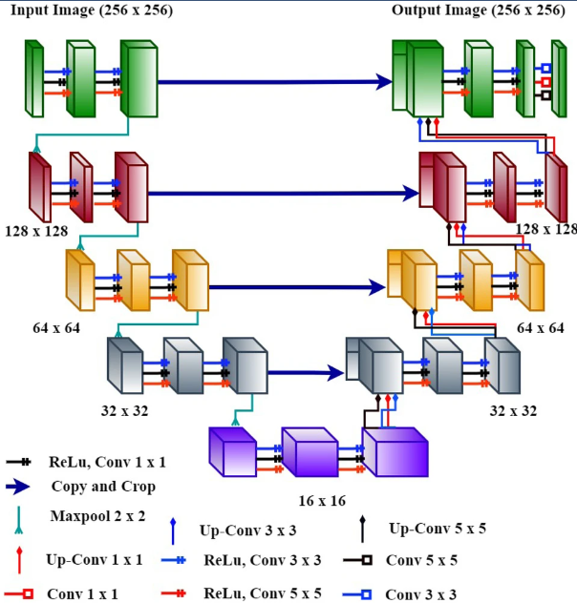
Solution Architecture Using U-Net Model
Our proposed improvements
Attention gates in skip connections
Improved focus
Reduced noise
Hybrid architecture for encoder
ResNet
DenseNet
Enhanced feature extraction
Capturing high feature sensitivity
Tweaking kernel size and sequence
Notes:
Contracting path (Encoder) → convolutional layer for extracting features, pooling layer for downsampling
Expanding path (Decoder) → upsampling, skip connections with the encoder
Use of 1x1, 3x3, 5x5 filters/kernels at each convolutional layer instead of only 3x3 → capture features at various levels of granularity (pixel-level, spatial details, broader context)
67 deep layers compared to U-net’s original 23 layers

Slide 5
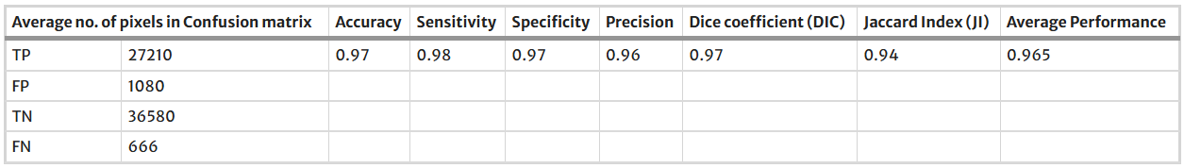
Performance Metrics
DIC = 2 * ∣A ∩ B∣ / (|A| + |B|) = 2 * TP / (2 * TP + FP + FN)
JI = ∣A ∩ B∣ / ∣A ∪ B∣ = DIC / (2 - DIC)
​
Notes:
The Dice Coefficient is a measure of overlap between the predicted segmentation (output of the model) and the ground truth (the actual labeled data). 1 indicates perfect overlap between the prediction and the ground truth (ideal segmentation), 0 indicates no overlap at all.
The Jaccard Index (also known as the Intersection over Union, IoU) is another metric that measures the similarity between the predicted and actual segmentation regions. 1 indicates a perfect match between the predicted and actual regions, 0 indicates no overlap at all.
Avg performance → mean of all metrics
True positive (TP) returns the pixels which are segmented correctly. False positive (FP) returns the number of pixels segmented mistakenly. True negative (TN) returns the number of pixels ignored correctly. False Negative (FN) returns the number of pixels ignored falsely.

